Slide 1
Telephone based self-management support for vascular conditions via non-healthcare professionals: a systematic review and meta-analysis
Dr Nicola Small, Greater Manchester Collaboration for Leadership in Applied Health Research and Care (CLAHRC), Research Associate.
Centre for Primary Care, and Manchester Academic Health Science Centre, University of Manchester.

Slide 2
Today
Context
Vascular self-management support
CLAHRC Randomised Controlled Trial
Systematic review
Results
Principal findings
Implications
Acknowledgements

Slide 3
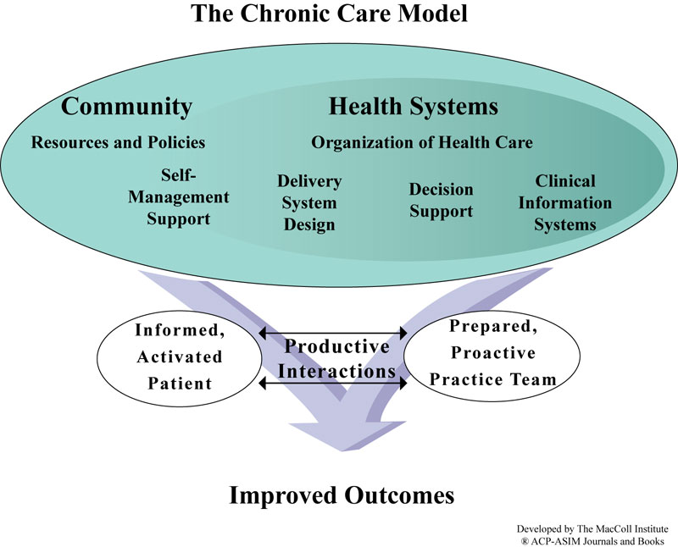
Background
Prevention of vascular disease
Chronic Care Model
Assessing cardiovascular risk
Effective self-management support

Slide 4
Self-management support via non-healthcare professionals
Reach socially disadvantaged populations
Lay health workers “… have no formal professional or paraprofessional education… broad in scope, includes community health workers, village health workers…”
(Lewin, 2005)
Peer support workers “… share salient
target population similarities such as
age or health concern…” (Dale, 2009)

Slide 5
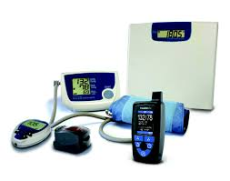
Telephone support
Efficacy delivering self-management
support via telephone
2 Cochrane reviews
Telephone support (n = 7)
Peer delivered to differing chronic + acute conditions
Improvements in self-management outcomes
Telemedicine + telephone support (n = 25)
Peer + HCP delivered to chronic heart failure
Reductions in hospitalisations + healthcare costs

Slide 6
Randomised Controlled Trial
2 Arm; CKD (Stage 3);
440 Patients from General Practices in Greater Manchester
‘Does a complex intervention improve
self-management and blood pressure control compared to usual CKD management?’

Slide 7
BRinging Information and Guided Help Together (BRIGHT) Self-Management Support Intervention

Slide 8
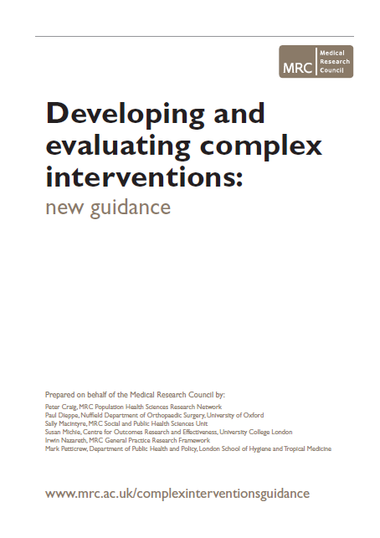
MRC Complex Intervention Framework
Coherent theoretical basis
Based on evidence
Implementation
Effective or cost-effective

Slide 9
Aim
Systematic review and meta-analysis
to assess the evidence on the effectiveness and
cost effectiveness of telephone self-management interventions for patients with vascular conditions
via non-healthcare professionals
Method
Established guidelines for reviews (Higgins, 2008)
Brief RCT Search Strategy for CENTRAL
Study quality (Risk of bias)
Meta-analysis (Standardised mean difference)

Slide 10
Criteria
Randomised Controlled Trials
Adults with vascular or associated vascular condition
Structured self-management (DoH) telephone support based on verbal communication only
Self-management telephone support was
both primary (main component) +
distinct (effects could be distinguished)
Delivered via non-healthcare professional
Calls not supportive in content
Calls were patient initiated
Telemedicine (e.g. storage + transmission
of data)

Slide 11
Study flow
Total studies = 5780
MEDLINE 1987 studies
CENTRAL 1172 studies
EMBASE 2621 studies
19 articles
415 articles
18 articles
9 excluded
405 excluded
9 excluded
10 (CENTRAL duplicates)
10
Met criteria
9 (CENTRAL
duplicates)
Total of 10 studies included

Slide 12
Characteristics
Included studies: 10
Published: 2005 - 2012
Country: 7 USA; 2 UK; 1 Canada
Design: 9 Individually randomised; 1 Clustered
Participants: 7 Diabetes; 2 Heart disease, 1 Hypertension
Interventions: 7 ‘peer’; 3 ‘lay health workers’
Training: 10 Motivational interviewing, behaviour change theory (self-efficacy, social support)

Slide 13
Study quality
 | Random sequence | Allocation concealment | Blinding participants | Blinding outcome | Incomplete outcome | Selective reporting
Turner | (√) | (?) | (√) | (√) | (√) | (X)
Walker | (√) | (?) | (X) | (X) | (√) | (X)
Heisler | (√) | (√) | (X) | (?) | (√) | (X)
Dale | (?) | (X) | (X) | (?) | (?) | (X)
Samuel | (√) | (X) | (X) | (?) | (√) | (?)
Parry | (√) | (√) | (X) | (?) | (√) | (?)
Batik | (X) | (?) | (X) | (?) | (?) | (?)
Carroll | (?) | (?) | (X) | (?) | (?) | (?)
Young | (√) | (√) | (?) | (?) | (√) | (?)
Keyserling | (√) | (X) | (X) | (X) | (√) | (X)

Slide 14
Self-management support

Slide 15
Mental health quality of life

Slide 16
Clinical (HBA1c)

Slide 17
Principal findings
Primarily based in community settings; USA; Diabetes; ‘Peer’ support workers
Small effects on self-management + HBA1c;
No effect on mental health; Limited data on health care utilisation + cost-effectiveness
Limited in scope + quality
Unable to assess type or intensity of
self-management support

Slide 18
Implications
Assume commonalities across vascular disorders
40% Diabetes patients have associated CKD
Limited evidence of impact on other outcomes
Insufficient data to inform development of interventions to assess effect on outcomes
Need for well designed trials in vascular population
Until then... remain dependent on theoretical considerations + patient experience studies

Slide 19
Acknowledgements
Co authors:
Christian Blickem¹
Tom Blakeman¹
Maria Panagioti¹
Carolyn A. Chew-Graham²
Peter Bower¹
BRIGHT team: People with Long-Term Conditions Theme¹
Greater Manchester Collaboration for Leadership in Applied Health
Research and Care, Centre for Primary Care, Manchester Academic
Health Science Centre, University of Manchester¹
Research Institute Primary Care and Health Sciences, Keele University²

